Slide 1
Intel Security UI Design Research Quantitative study Report
Insights, Market Research & Analytics (IMRA)
January 25, 2016

Slide 2
Table of Contents
Business & Research Objectives | 3 | Chapter 4: US Consumer Mobile Concepts | 27
Methodology & Participants | 4 | Chapter 5: Product Emotions & Attributes | Consumers | 32
Scorecard | 8 | Section 2: Quantitative B2B Insights | 38
Quantitative Phase Summary | 9 | Chapter 6: US B2B Concepts | 39
Linguistic Coding Insights | 10 | Chapter 7: Japan B2B Concepts | 44
Section 1: Quantitative Consumer Insights | 11 | Chapter 8: Germany B2B Concepts | 49
Chapter 1: US Consumer PC Concepts | 12 | Chapter 9: Product Emotions & Attributes | B2B | 54
Chapter 2: Japan Consumer PC Concepts | 17 | Section 3: Design Insights & Recommendations | 59
Chapter 3: Germany Consumer PC Concepts | 22 | Appendix | 68
This report contains closed and open ended quantitative insights for consumers and B2B

Slide 3
Business & Research Objectives
Research Objectives
Determine the strongest design concept. Identify UI design elements to consider including in Intel Security UI guidelines
Assess alignment with key Intel design principles
Assess Intel Security attributes and emotions triggered by concepts
Identify which emotions are desired while using a security product
Help Intel Security develop the strongest design guidelines
Business Objective

Slide 4
Methodology & Participants
20 minute online interviews among consumers and B2B
Fielded 12/3/15 to 12/17/15 in 3 markets: US, Japan and Germany
Qualification Criteria:
No sensitive industry affiliations
Age 18-64
Thinks security products are important
Has relevant security products
Consumers:
Uses a PC (PC concepts) or uses a smartphone (Mobile concept)
Decision maker for security software
Prioritized the following Intel Consumer Segments: Savvy Adopters, Mobile Achievers, Basic Connectors & Tool ‘n Taskers
B2B:
Works full-time
Not sole employee at company
Prioritized ITDMs* and Enterprises (250+ employees)
Monadic design: respondents assigned to evaluate one of three concepts
Assignment to concepts balanced on key characteristics
US consumers assigned to PC vs. Mobile based on balancing and device-based eligibility
 | US PC | US Mobile | Japan PC | Germany PC
Consumer Total | 305 | 295 | 300 | 301
Priority Segments | 230 | 221 | 225 | 226
B2B Total | 400 | - | 399 | 400
Total ITDMs* | 350 | - | 349 | 350
Total Business End Users | 50 | - | 50 | 50
Role (among Total B2B)
Upper Management (e.g., IT Director, CTO, VP Network Operations, etc.) | 309 | - | 200 | 305
IT Operator / Security Analyst | 40 | - | 146 | 48
Other IT Persona | 4 | - | 5 | 3
Non-IT End User | 47 | - | 48 | 44
Company Size (among Total B2B)
Enterprise Employee (company with 250+ employees) | 336 | - | 249 | 330
Non-Enterprise Employees | 64 | - | 150 | 70
* Works in IT and makes decisions regarding IT security solutions and products or implements security solutions
Notes:
Security-Specific Roles Sample Sizes:
US = 121
DE = 93
JP = 82
Security-related roles included in the above sample sizes:
- Chief Security Officer
- CISO
- IT / IS Director or Manager
- Security Analyst
- Security Architect
- Security Content Developer
- Security Engineer
- Security Manager
- VP of IT or IS

Slide 5
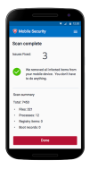
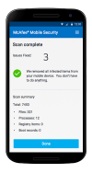
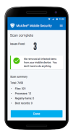
Methodology | Consumer Mobile Concepts Tested
SPLASH
SCAN RESULTS
SCAN COMPLETE
Concept A
Concept B
Concept C
NOTE: See Appendix for larger versions of stimuli.

Slide 6
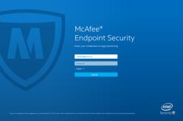
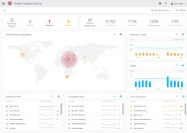
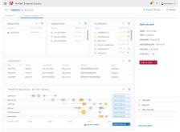
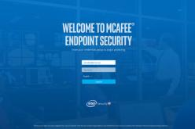
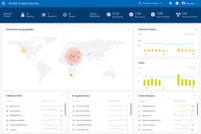
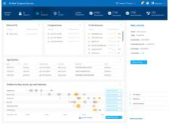
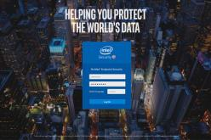
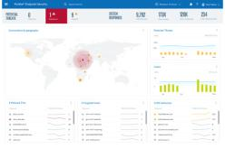
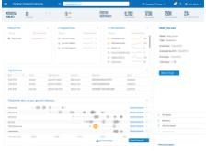
Methodology | B2B Concepts Tested
LOGIN
DASHBOARD
DRILLDOWN
Concept A
Concept B
Concept C
NOTE: US stimuli shown here. See Appendix for German and Japanese stimuli and larger versions of US stimuli.

Slide 7
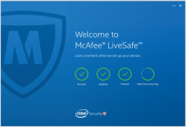
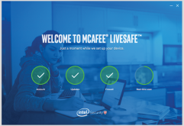
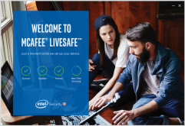
Scorecard | Consumers & B2B
Concept C performs strongly across markets among both Consumers and B2B; Concepts A and B also have elements that perform strongly and should be leveraged
Concept A has strongest Welcome / Splash Screen for consumers
Concept B has strong lettering, especially for consumers, and is strong for Mobile
CONSUMERS
B2B
CONSUMERS | US PC | Japan PC | Germany PC | US Mobile
Strongest Concept Overall | C | C | B / C | B
Welcome / Splash Screen | A | A | A / B | A
Home / Scan Results / Scan Completed Screens | C | C | B / C | B
A
A
B
B
B2B
Strongest Concept Overall | C | C | B / C
Login Screen | C | A / C | C
Dashboard / Drilldown Screens | C | C | B / C
C
C
NOTE: First screen of US stimuli shown here for reference.

Slide 8
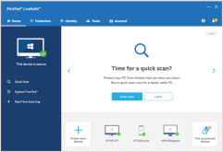
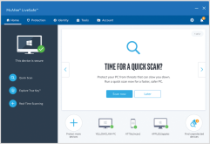
Quantitative Phase Summary
While all concepts have strengths, C is the strongest overall
Across markets, B and C’s blue color scheme, strong color contrasts and bold text are visually appealing and aid navigation
For consumers, A's more simple Welcome / Splash Screen is preferred since many find the images of people in B and C polarizing and unrelatable
For B2B, cityscape images in Concept C’s Login Screen are visually appealing
Concept B
Consumer
Concept C
Consumer
Concept A
Consumer
Concept C
B2B
In general, respondents expect to feel safe and secure when using a security product (similar to Intel Security CBT 2015)
Of emotions tested, these security products are most aligned with “peace of mind” and “confident” (e.g., safe, secure, protected) and align least with amazing and free
Of the attributes tested, Intel Corporate Brand Attribute “smart” is among the top associations in several markets
When describing the products in their own words, consumers focus on what the product would feel like to use (e.g., easy, user-friendly) whereas B2B respondents focus on product functionality (e.g., detecting problems, stopping threats)
Notes:
Question text for ratings of emotion importance (second blue box): F1. Imagine you are using a security software product in general. For each of the statements below, please rate how important it is that a security software product makes you feel....
Question text for ratings of attribute associations (second blue box): GR1. Thinking about the product and all three screens you just saw, please decide whether the word you see on the screen describes the product. Does the word describe the product?
Question text for ratings of emotion associations (second blue box): GR2.Now, we’d like you to imagine that you are using the product you just saw. Please decide whether the word on the screen describes how you imagine you’d feel while using or after using the product. Does the word describe how you would feel while using the product?
Question text for linguistic coding (bottom blue box): L1. Now, imagine your friend / colleague is in the market for a new security software product. Using the information you have, convince your friend / colleague to buy the product by describing the product and its qualities. Please be as detailed as possible in providing all the reasons you think your friend / colleague should buy this product.

Slide 9
Linguistic coding reveals that consumers focus on the experience of using the product while B2B respondents focus on product functionality
Consumer & B2B All Markets | Linguistic Coding
Linguistic Coding Findings | What To Do | In Their Own Words
Both groups use positive emotions, driven by easy and friendly, but consumers do so more than B2B respondents | Make sure design communicates that product features are easy to use and ensure product delivers on this | “This is a very easy to use, user-friendly software protection.” Consumer “Really easy to use, user-friendly and simple to follow.” Consumer
Consumers also use appearance- related words (appear, look) more than B2B, suggesting they are guessing about features more |  | “It looks very easy to use, and what I have seen makes it look like it explains very well.” Consumer “It appears to be easy to use.” Consumer
Both groups use threat and protection-related words, but B2B respondents do so more than consumers | For B2B, make sure design communicates functionality and ensure that product delivers on this | “You will see a comprehensive list of all potential threats to security.” B2B “It keeps the system safe and protected from threats.” B2B
User Experience
Product Functionality
L1. Now, imagine your friend / colleague is in the market for a new security software product. Using the information you have, convince your friend / colleague to buy the product by describing the product and its qualities. Please be as detailed as possible in providing all the reasons you think your friend / colleague should buy this product.

Slide 10
SECTION 1 QUANTITATIVE CONSUMER INSIGHTS

Slide 11
Chapter 1
US CONSUMER PC CONCEPTS

Slide 12
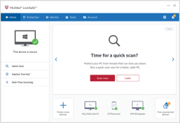
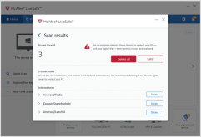
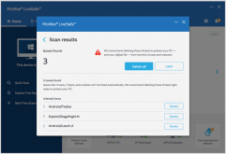
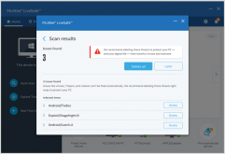
For US PC Consumers, Concept C is highest on likelihood to purchase and product attributes, though all concepts are rated relatively high
US Consumer PC | Overall Ratings
 | Overall Opinion (Top 2 Box) | 83% | 80% | 84%
 | Likelihood to Purchase (Top 2 Box) | 72% | 71% | 81%
Concept A
n = 98
Concept B
n = 105
Concept C
n = 102
Product Attributes
(Top 2 Box)
Note: Capital letters indicate statistical significance at the 90% confidence level.
R1. Thinking about the product overall, please rate whether you agree or disagree with each statement.
R2. Overall, how much do you like the security product?
R3. If it was at a price you found acceptable, could comprehensively serve your IT security needs and you were in the market for a new security product, how likely are you to buy the security product?

Slide 13
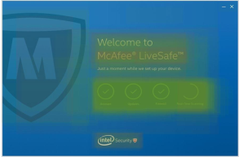
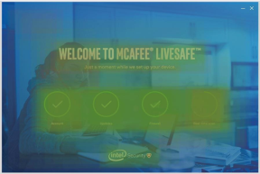
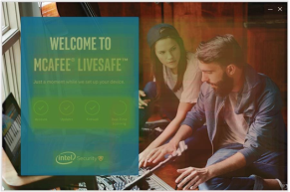
However, Concept C’s Welcome Screen is polarizing due to the people shown, and thus, has an opportunity to be improved using A’s approach
US Consumer PC | Welcome Screen
Implication: Avoid using images of consumers since they are polarizing
+
+
Cross-Concept Insights:
Intel Security logo well-liked because Intel brand instills trust
Consumers like loading icons because they offer a visually appealing summary of key capabilities
Concept A
Concept B
Concept C
Chosen as Favorite*:
37%C
37%C
26%
+
-
+
Concept A is safe – while it has lower engagement (# of clicks), it also has fewer negative comments
A is liked because of the clean, simple design
“I like the simplicity.”
Weakest on background color because wash dilutes impact of both the color and the image
“Do not like the overall blue wash. Too bland.”
Font in Concept C rated as easiest to read because of bold Intel Clear Pro font over solid-colored background
Many of the comments about background image are negative since not all can relate to the people shown and many do not see why they are relevant to the product
“You can't really see what they are doing. Seems very random.”
+
-
NOTE: See appendix for an explanation of the heat maps above
* Among Total US PC Consumers (n = 305) in head-to-head competition.
Note: Capital letters indicate statistical significance at the 90% confidence level.
EX1. Overall, which of these three versions do you prefer?
R1a. Thinking specifically about the welcome screen (Screen1), please rate whether you agree or disagree with each statement.

Slide 14
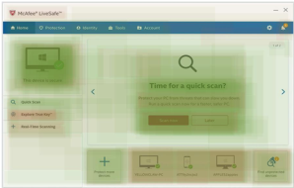
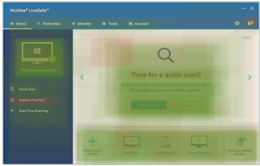
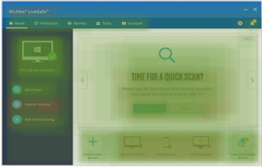
Concept C's Home Screen is the strongest – consumers like the color contrasts on menu and icons
US Consumer PC | Home Screen
Implication: Use a few shades of darker colors for the background on the navigation and menu bars, as contrast is appealing
-
Cross-Concept Insights:
Many are confused by “Explore True Key” due to lack of knowledge on what it is
Chosen as Favorite*:
Concept A
Concept B
Concept C
25%
32%A
43%AB
-
+
+
Menu hardest to understand and recommended action least clear because monotone coloring is less effective at guiding focus
Side menu and top bar receive fewest positive clicks since white background is less attention-grabbing and does not cue a separate area of page
“Scan now” and “Later” buttons receive more positive comments in B and C vs. A, suggesting Intel coloring is preferred to McAfee coloring
Consumers like the use of multiple colors on side bar and top bar best on C because color contrast is appealing and helps differentiate areas
“User friendly, easy to understand tool bar.”
Icons are liked best and recommended action is most clear on C since pops of bright color on icons help draw attention to important pieces of information
“I like the graphic of the magnifier and it stands out.”
-
+
* Among Total US PC Consumers (n = 305) in head-to-head competition.
Note: Capital letters indicate statistical significance at the 90% confidence level.
EX2. Overall, which of these three versions do you prefer?
R1b. Thinking specifically about the home screen (Screen 2), please rate whether you agree or disagree with each statement.

Slide 15
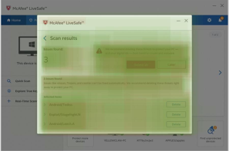
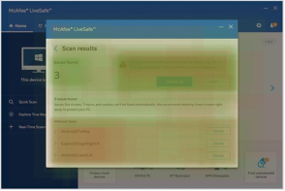
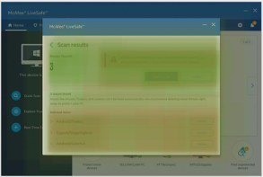
Across the three screens, the text in Concepts B and C is easier to read than in Concept A
US Consumer PC | Scan Results Screen
Implication: Use contrasting colors to improve text readability; incorporate Intel (blue) buttons vs. McAfee (red) buttons
Concept A
Concept B
Concept C
-
+
+
Text rated hardest to understand because more monotone color palette makes pop up window and menus blend in with the rest of the screen, making navigation more difficult
“Hard to read.”
Red buttons (“Delete all” / “Later”) receive less positive attention than blue buttons in B and C since red typically connotes danger, a negative emotion
“Dangerous looking.”
Recommended action to take rated as most clear in Concept B because of bolded text and color contrasts that draw the eye to important information
“Simple design, easy to find buttons, easy to understand.”
“The whole thing is easy to understand, user friendly, clean looking.”
Consumers again like the icons in Concept C best because the pop of color makes them stand out
“Such a simple, easy to use interface. Love it.”
-
R1c. Thinking specifically about the scan results screen (Screen 3), please rate whether you agree or disagree with each statement.

Slide 16
Chapter 2
JAPAN CONSUMER PC CONCEPTS

Slide 17
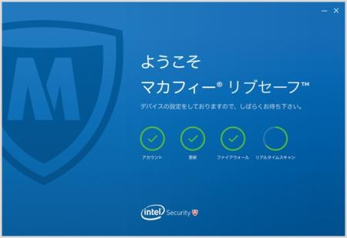
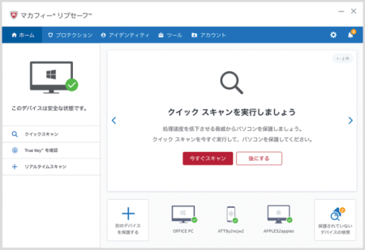
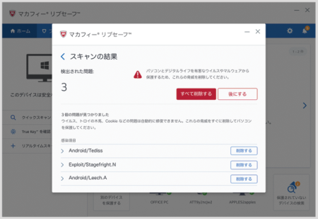
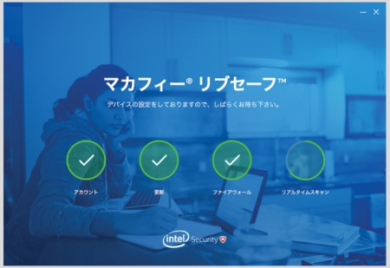
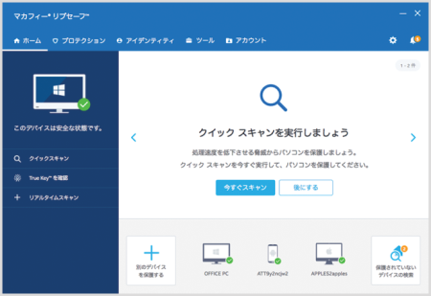
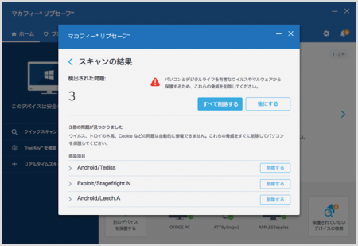
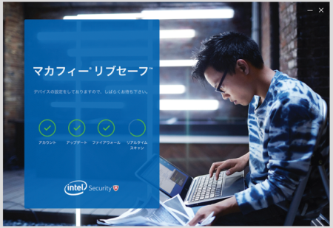
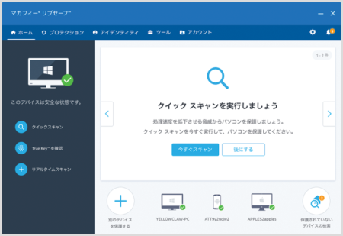
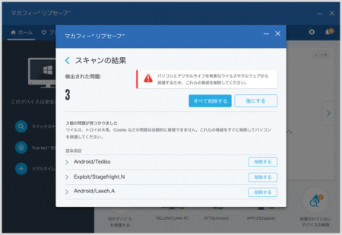
In Japan, PC consumers like Concept C the most and rate it as the easiest to use and the most consistent in look and feel
Japanese Consumer PC | Overall Ratings
Concept A
n = 102
Concept B
n = 99
Concept C
n = 100
 | Overall Opinion (Top 2 Box) | 56% | 57% | 66%
 | Likelihood to Purchase (Top 2 Box) | 57% | 50% | 58%
Product Attributes
(Top 2 Box)
Note: Capital letters indicate statistical significance at the 90% confidence level.
R1. Thinking about the product overall, please rate whether you agree or disagree with each statement.
R2. Overall, how much do you like the security product?
R3. If it was at a price you found acceptable, could comprehensively serve your IT security needs and you were in the market for a new security product, how likely are you to buy the security product?

Slide 18
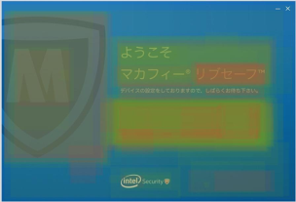
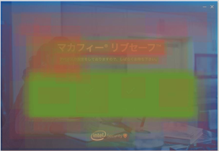
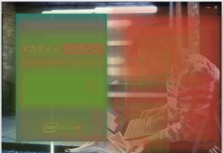
However, Japanese consumers strongly prefer the simplicity of Concept A’s Welcome Screen A vs. photos in B and C
Japanese Consumer PC | Welcome Screen
Implication: Avoid use of color washes and images of consumers
Cross-Concept Insights:
+
Loading icons are again well-liked since they convey important information in an eye-catching manner
-
Many find “LiveSafe” confusing because they are unfamiliar with the term
Concept A
Concept B
Concept C
Chosen as Favorite*:
60%BC
21%
20%
+
-
-
Concept A receives fewest negative comments and highest ratings for “I like images used” because consumers like the clean, simple layout
“[I like it] because of the refined layout.”
As in the US, color wash in B is again weakest since the image behind it makes the blue less saturated
“I don’t like the coloring.”
Image of consumer receives negative comments since it distracts from messaging and not all can relate to the woman
“[Message] overlapped with the woman's face.”
“Men are better.”
The photo yields a large amount of negative feedback as consumers don't find the man relatable, appealing or relevant to the product
“I hate the pattern of clothes.”
“Women look better.”
Consumers are less likely to say C is easy to understand vs. A and B, suggesting image is distracting and forces text to be smaller
-
-
* Among Total Japanese PC Consumers (n = 301) in head-to-head competition.
Note: Capital letters indicate statistical significance at the 90% confidence level.
EX1. Overall, which of these three versions do you prefer?
R1a. Thinking specifically about the welcome screen (Screen 1), please rate whether you agree or disagree with each statement.

Slide 19
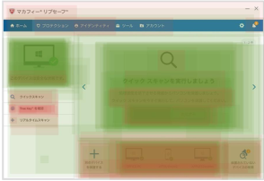
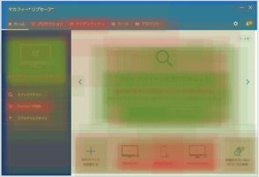
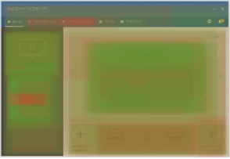
Consumers prefer Concept C’s Home Screen because the contrast between the different blues used draw attention and aid navigation
Japanese Consumer PC | Home Screen
Implication: Use high contrast color schemes and avoid monotone ones; Ensure all text is Japanese to increase clarity
-
Cross-Concept Insights:
The “Protect more devices” section receives negative comments because it has English text, which many cannot read
Concept A
Concept B
Concept C
Chosen as Favorite*:
30%
32%
37%A
-
-
+
White side bar receives lowest proportion of positive comments because color is less eye catching than that of B and C
Recommended action is rated as less clear than C, suggesting lack of contrasting colors at top bar and on icons makes identifying key information more difficult
“It may be difficult for beginners to understand.”
“It does not attract attention only with blue.”
Recommended action clearest and consumers more likely to say C is easy to understand vs. A and B since color contrasts help identify important information
As in US, side bar receives highest proportion of positive comments, suggesting pop of color at icons and strong color contrast between this area and rest of screen are well-liked
+
* Among Total Japanese PC Consumers (n = 301) in head-to-head competition.
Note: Capital letters indicate statistical significance at the 90% confidence level.
EX2. Overall, which of these three versions do you prefer?
R1b. Thinking specifically about the home screen (Screen 2), please rate whether you agree or disagree with each statement.

Slide 20
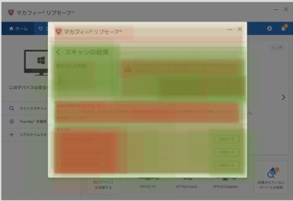
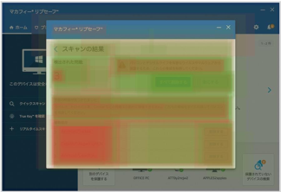
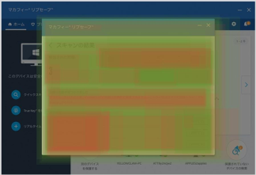
On the Scan Results Screen, Japanese consumers again like the coloring of Concept C best due to readability and contrast
Japanese Consumer PC | Scan Results Screen
Implication: Use coloring from Intel (vs. McAfee), especially for navigation buttons (blue vs. red); avoid non-Japanese text
-
Cross-Concept Insights:
“Infected items” area not well-liked, again due to non-Japanese text which not all consumers can read
Concept A
Concept B
Concept C
-
+
+
Receives lowest ratings for “Icons make sense”, suggesting that red icon buttons do not stand out from red navigation buttons
Like in US, B and C’s blue “Delete all” / “Later” buttons receive more positive comments than A’s red buttons since blues are more calming and do not distract from red warning icons
“It’s easy to understand.”
Menu rated as easiest to understand, suggesting color contrasts and colored icons aid navigation
“The results of the scanning is easy to understand.”
“The blue color caught my eyes.”
Coloring is stronger in C vs. A and B, perhaps due to a greater variety of colors or appeal of the dark gray
“Hues are well done and I like it.”
+
R1c. Thinking specifically about the scan results screen (Screen 3), please rate whether you agree or disagree with each statement.

Slide 21
Chapter 3
GERMANY CONSUMER PC CONCEPTS

Slide 22
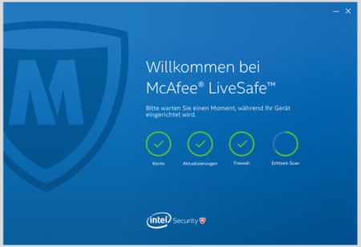
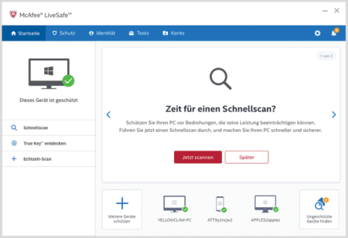
At an overall level, Concept B performs best in Germany
German Consumer PC | Overall Ratings
 | Overall Opinion (Top 2 Box) | 77% | 84% | 78%
 | Likelihood to Purchase (Top 2 Box) | 62% | 70% | 65%
Concept A
n = 97
Concept B
n = 100
Concept C
n = 103
Product Attributes
(Top 2 Box)
Note: Capital letters indicate statistical significance at the 90% confidence level.
R1. Thinking about the product overall, please rate whether you agree or disagree with each statement.
R2. Overall, how much do you like the security product?
R3. If it was at a price you found acceptable, could comprehensively serve your IT security needs and you were in the market for a new security product, how likely are you to buy the security product?

Slide 23
Like consumers in US and Japan, German consumers like Concept C’s Welcome Screen least because images of consumers are not well liked
German Consumer PC | Welcome Screen
Implication: Use bold text to draw attention and avoid images of consumers
Cross-Concept Insights:
+
Loading icons and Intel logo receive positive feedback – icons show how the product works and presence of Intel instills trust
Concept A
Concept B
Concept C
Chosen as Favorite*:
38%C
35%C
27%
+
+
-
Background color strongest, since solid color (vs. B’s color wash) is more saturated and bold
“Beautiful colors, attractive logo.”
Font hardest to read and generates less attention since Intel Clear Pro font used in B and C is bolder and more appealing
“[The font is] too small.”
Welcome statement receives most positive comments and text color is strongest because large, bold lettering centered in screen helps message stand out
“Nice welcome.” “Well laid out.”
Mixed reactions to girl’s face, again suggesting that images of people are polarizing and pull focus away from product capabilities
“The woman looks bored.”
Image is weakest and draws highest proportion of negative comments since German consumers do not like the people in the photo or see their relevance
“The background image is not suitable – is it supposed to be hip?”
“Why does the guy have a full beard?”
-
-
* Among Total German PC Consumers (n = 300) in head-to-head competition.
Note: Capital letters indicate statistical significance at the 90% confidence level.
EX1. Overall, which of these three versions do you prefer?
R1a. Thinking specifically about the welcome screen (Screen 1), please rate whether you agree or disagree with each statement.

Slide 24
For the Home Screen, consumers prefer Concepts B and C to A, since the more monotone color palette of A is less visually stimulating
German Consumer PC | Home Screen
Implication: Using multiple hues of bold colors in background increases visual interest and makes it easier to identify important information
Concept A
Concept B
Concept C
Chosen as Favorite*:
20%
39%A
26%
-
+
+
Elicits lowest proportion of positive comments because colors are not as appealing as blues used in concepts B and C
“Too simple.”
“The background should be blue like the startup screen.”
Icons are liked the least because red navigation bars pull attention away from icons
Text and background color are strongest; B is easiest to understand, suggesting combination of multiple hues of blue and bold text in key areas help direct attention to important information
“Simple structure, clearly visible.”
“Clear presentation, easy to use.”
Upper bar, side bar and side menu elicit the most positive engagement since multiple hues of blue and pops of colors at icons grab attention and differentiate the various components of the screen
“Graphics and color selection are very good.”
“I like the design.”
-
* Among Total German PC Consumers (n = 300) in head-to-head competition.
Note: Capital letters indicate statistical significance at the 90% confidence level.
EX2. Overall, which of these three versions do you prefer?
R1b. Thinking specifically about the home screen (Screen 2), please rate whether you agree or disagree with each statement.

Slide 25
German consumers find Concepts B and C easier to use than A because A’s red navigation buttons distract from red warning icons
German Consumer PC | Scan Results Screen
Implication: Use blue (vs. red) in navigation buttons since calming blue does not draw attention away from red warning icons
Concept A
Concept B
Concept C
-
+
+
Recommended action is least clear since using red for both navigation buttons and warning icons can be confusing
Menu and icons are clear and rated easiest to understand because bolded text shows what is important and calming blues in navigation buttons allow red warning icons to stand out
“It's immediately clear how many problems there are.”
“The beautiful red color draws a lot of attention.”
Consumers are more likely to comment on the ease / simplicity of C vs. A since strong color contrasts and reserving red for warning icons direct attention to key information
“Simple and concise.”
“Good, clear display.”
R1c. Thinking specifically about the scan results screen (Screen 3), please rate whether you agree or disagree with each statement.

Slide 26
Chapter 4
US CONSUMER MOBILE CONCEPTS

Slide 27
US Mobile consumers like Concept B the best – they rate it more favorably across a number of metrics and are more likely to purchase it
US Consumer Mobile | Overall Ratings
 | Overall Opinion (Top 2 Box) | 82% | 90% | 83%
 | Likelihood to Purchase (Top 2 Box) | 72% | 88%AC | 76%
Concept A
n = 93
Concept B
n = 99
Concept C
n = 103
Product Attributes
(Top 2 Box)
Note: Capital letters indicate statistical significance at the 90% confidence level.
R1. Thinking about the product overall, please rate whether you agree or disagree with each statement.
R2. Overall, how much do you like the security product?
R3. If it was at a price you found acceptable, could comprehensively serve your IT security needs and you were in the market for a new security product, how likely are you to buy the security product?

Slide 28
For the Splash Screen, Concept A is preferred – many consumers have negative reactions to the images of people, especially in Concept C
US Consumer Mobile | Splash Screen
Implication: Simplicity works best for mobile concepts – avoid images of people
+
Cross-Concept Insights:
Intel Security logo is again well-liked because consumers like and trust Intel
Concept A
Concept B
Concept C
Chosen as Favorite*:
51%BC
32%C
17%
+
+
-
Similar to PC concepts, A has lowest engagement, but fewest negative reactions, suggesting the clean, simple design is safe
B’s welcome message in bold text right in the center of screen leads to highest ratings of text readability
“Nice bold text.”
Many do not like photo and think color wash makes image harder to see
“I don’t like the fuzziness of the picture.”
“You can barely see the picture on the background.”
Majority of comments on background image are negative and say image is not relevant since they cannot see that people in the picture are using a computer
“The picture doesn't go with this.”
“Why are there people there?”
-
* Among Total US Mobile Consumers (n = 295) in head-to-head competition.
Note: Capital letters indicate statistical significance at the 90% confidence level.
EX1. Overall, which of these three versions do you prefer?
R1a. Thinking specifically about the splash screen (Screen 1), please rate whether you agree or disagree with each statement.

Slide 29
On the Scan Results Screen, A is chosen as the favorite, but B receives more positive clicks and is rated most favorably
US Consumer Mobile | Scan Results Screen
Implication: Use bright reds for warning icons but not navigation buttons to drive clarity; negative first reactions have the potential to impact feelings about later screens
-
Cross-Concept Insights:
“Infected items” area receives negative comments due to confusion about what the items refer to
NOTE: Concept A might have been preferred in the head-to-head ratings because it is more distinct, whereas B and C look more similar to each other
Concept A
Concept B
Concept C
Chosen as Favorite*:
64%BC
21%C
14%
-
+
-
Recommended action is least clear, suggesting red on both navigation buttons and warning icons is confusing
“Issues found should be more pronounced.”
“Not sure what this means”
Consumers like the bright red icons in B the best and think they make the most sense since they stand out from blue navigation buttons and are accompanied by bold text
“The red triangle gets my attention and lets me know something is wrong.”
Given the similarities between the Scan Results Screens of B and C, lower ratings for C vs. B might be due to residual negative feelings from C’s Splash Screen, which was not well-received
* Among Total Mobile Consumers (n = 295) in head-to-head competition.
Note: Capital letters indicate statistical significance at the 90% confidence level.
EX2. Overall, which of these three versions do you prefer?
R1b. Thinking specifically about the scan results screen (Screen 2), please rate whether you agree or disagree with each statement.

Slide 30
For the Scan Complete Screen, combination of coloring and font drives higher ratings for Concept B
US Consumer Mobile | Scan Complete Screen
Implication: Avoid red navigation buttons to decrease confusion
-
Cross-Concept Insights:
Scan summary is confusing since language is not consumer-facing and does not clearly explain what numbers represent
Concept A
Concept B
Concept C
Chosen as Favorite*:
-
+
-
Recommended action is least clear for Concept A and text color is liked the least, again suggesting red buttons are not well-liked and do not aid navigation
“There is nothing that stands out.”
“Confusing.”
Recommended action is most clear for B because of the helpful combination of red warning icons, blue navigation buttons and bold text
”Again, perfect, simple and helpful design that assures me this product is protecting me and my equipment.”
C’s Scan Complete Screen might be weaker than B’s in part because negative reactions to C’s Splash Screen might have carried over, whereas reactions to B’s Splash Screen were less negative
R1c. Thinking specifically about the scan complete screen (Screen 3), please rate whether you agree or disagree with each statement.

Slide 31
Chapter 5
PRODUCT EMOTIONS & ATTRIBUTES | CONSUMERS

Slide 32
Across all markets, consumers rate safe, secure and protected as the most important emotions to feel when using a security product
All Markets | Emotion Importance (Top 2 Box)
Total US PC
n = 305
Total Japanese PC
n = 301
Total German PC
n = 300
Total US Mobile
n = 295
Desired emotions when using a security product relate to security territories “peace of mind” and “confident”; aspirational emotions (e.g., optimistic, free, amazing) are less important
F1. Imagine you are using a security software product in general. For each of the statements below, please rate how important it is that a security software product makes you feel....

Slide 33
A key theme across concepts is peace of mind (e.g., protected, secure, safe), which closely aligns with desired emotions
US Consumer PC | Top 10 Strongest Emotions / Attributes with Concept (% ‘Yes’)
Concept A
n = 98
Concept B
n = 105
Concept C
n = 102
NOTE: Though both emotions and attributes are shown here, they were tested separately
Most Important Emotions:
Safe
Secure
Protected
Protected, effective, secure and safe are top emotions / attributes that are related to security territories “confident” and “peace of mind”; Intel Corporate Brand Attribute “smart” also pops
Note: Capital letters indicate statistical significance at the 90% confidence level.
GR1. Thinking about the product and all three screens you just saw, please decide whether the word you see on the screen describes the product. Does the word describe the product?
GR2. Now, we’d like you to imagine that you are using the product you just saw. Please decide whether the word on the screen describes how you imagine you’d feel while using or after using the product. Does the word describe how you would feel while using the product?

Slide 34
Similarly, Japanese consumers associate the concepts with strongly desired security-related emotions
Japanese Consumer PC | Top 10 Strongest Emotions / Attributes with Concept (% ‘Yes’)
Concept A
n = 102
Concept B
n = 99
Concept C
n = 100
Most Important Emotions:
Safe
Secure
Protected
Top associations align with security territories “confident” and “peace of mind”; Intel Corporate Brand Attribute “smart” is also strong
Note: Capital letters indicate statistical significance at the 90% confidence level.
GR1. Thinking about the product and all three screens you just saw, please decide whether the word you see on the screen describes the product. Does the word describe the product?
GR2. Now, we’d like you to imagine that you are using the product you just saw. Please decide whether the word on the screen describes how you imagine you’d feel while using or after using the product. Does the word describe how you would feel while using the product?

Slide 35
German consumers also feel the concepts align well with desired emotions safe, secure and protected
German Consumer PC | Top 10 Strongest Emotions / Attributes with Concept (% ‘Yes’)
Concept A
n = 97
Concept B
n = 100
Concept C
n = 103
Most Important Emotions:
Safe
Secure
Protected
Concepts again align with security territories; Intel Corporate Brand Attribute “bold” is also a top association
Note: Capital letters indicate statistical significance at the 90% confidence level.
GR1. Thinking about the product and all three screens you just saw, please decide whether the word you see on the screen describes the product. Does the word describe the product?
GR2. Now, we’d like you to imagine that you are using the product you just saw. Please decide whether the word on the screen describes how you imagine you’d feel while using or after using the product. Does the word describe how you would feel while using the product?

Slide 36
For US Mobile consumers, the concepts again deliver on emotions associated with peace of mind
US Consumer Mobile | Top 10 Strongest Emotions / Attributes with Concept (% ‘Yes’)
Concept A
n = 93
Concept B
n = 99
Concept C
n = 103
Most Important Emotions:
Secure
Safe
Protected
Similar to PC, security territories “peace of mind” and “confident” align with all concepts, as does Intel Corporate Brand Attribute “smart”
Note: Capital letters indicate statistical significance at the 90% confidence level.
GR1. Thinking about the product and all three screens you just saw, please decide whether the word you see on the screen describes the product. Does the word describe the product?
GR2. Now, we’d like you to imagine that you are using the product you just saw. Please decide whether the word on the screen describes how you imagine you’d feel while using or after using the product. Does the word describe how you would feel while using the product?

Slide 37
SECTION 2 QUANTITATIVE B2B INSIGHTS

Slide 38
Chapter 6
US B2B CONCEPTS

Slide 39
When assessed independently of other concepts, C is slightly weaker than A and B, but C is favored in direct comparisons (see following slides)
US B2B | Overall Ratings
 | Overall Opinion (Top 2 Box) | 89% | 89% | 85%
 | Likelihood to Purchase (Top 2 Box) | 90%C | 85% | 82%
Concept A
n = 130
Concept B
n = 137
Concept C
n = 133
Product Attributes
(Top 2 Box)
Note: Capital letters indicate statistical significance at the 90% confidence level.
R1. Thinking about the product overall, please rate whether you agree or disagree with each statement.
R2. Overall, how much do you like the security product?
R3. If it was at a price you found acceptable, could comprehensively serve your IT security needs and you were in the market for a new security product, how likely are you to buy the security product?

Slide 40
B2B respondents in the US like the bold cityscape used in C’s Login Screen
US B2B | Login Screen
Implication: Bold images of cityscape draw attention; explain relationship between Intel and McAfee or focus on only one brand to avoid confusion
Cross-Concept Insights:
+
-
Though both Intel and McAfee are liked, presence of both brands is confusing to some
+
Intel logo well liked because Intel is a trusted brand
Respondents like that the login adds extra security
Chosen as Favorite*:
Concept A
Concept B
Concept C
29%B
17%
54%AB
+
-
+
McAfee shield in background receives positive comments due to simple, clean design and positive brand associations
“Nice logo in the background.”
“Great security brand.”
Background liked least because respondents want a stronger color contrast and find the color wash over image too busy
“The background could be better.”
“I'd prefer a simple background color and not an image.”
Respondents like the slogan and cityscape because they are eye-catching and interesting
“Nice background. Has a modern feel to it.”
“[Slogan] stands out.”
* Among Total US B2B (n = 400) in head-to-head competition.
Note: Capital letters indicate statistical significance at the 90% confidence level.
EX1. Overall, which of these three versions do you prefer?
R1a. Thinking specifically about the login screen (Screen1), please rate whether you agree or disagree with each statement.

Slide 41
In US, Concept C’s menu bar is liked most due to the large, Intel Clear Pro font that makes it easy to see key information
US B2B | Dashboard Screen
Implication: B2B respondents like bold color contrasts and bold text because they draw attention to important information
+
-
-
Cross-Concept Insights:
Menu well-liked because it makes key information easy to find
+
While the map is visually appealing to some, others find it confusing and taking up space
Event count tables are confusing because they show too much information in too small a space
Concept A
Concept B
Concept C
Chosen as Favorite*:
19%
33%A
48%AB
-
-
+
Menu bar least favorite because whites and grays are less visually appealing than bold blues used in B and C
B’s menu bar receives fewer positive comments vs. C’s, since large text in C makes it easier to quickly understand key information whereas B’s icons require an extra layer of interpretation
“Should be more prominent, maybe bold or a different color.”
Menu bar elicits more positive comments in C than A and B because C shows key numbers with large, easy-to read Intel Clear Pro font (vs. using that space for icons like in A and B) and identifies threats with an eye-catching red background
“This is easy to read, understand, and respond to. Especially the red highlighted threat.”
* Among Total US B2B (n = 400) in head-to-head competition.
Note: Capital letters indicate statistical significance at the 90% confidence level.
EX2. Overall, which of these three versions do you prefer?
R1b. Thinking specifically about the dashboard screen (Screen 2), please rate whether you agree or disagree with each statement.

Slide 42
Across concepts, most B2B respondents in US find the timeline confusing, suggesting a need for a more simple display
US B2B | Drilldown Screen
Implication: It is important to show information conveyed in the menu bar across screens, since ITDMs find these stats useful and important
-
Cross-Concept Insights:
Some like the timeline since it conveys data in an interesting way, but most say it is too complicated and confusing
Concept A
Concept B
Concept C
-
+
+
Majority of comments on menu bar of B and C are positive, suggesting adding a menu bar to Concept A would be helpful
Continuing to show the menu bar in the Drilldown Screen, like B and C do, helps navigation because it creates a sense of continuity across screens
“Nice that pertinent info stays within view at all times.”
For Concepts B and C, many say they like the top portion because the important information shown in the Dashboard is still shown at the Drilldown
“Like the summary of system responses at the top of the page.”
“Stats are very useful.”
R1c. Thinking specifically about the drilldown screen (Screen 3), please rate whether you agree or disagree with each statement.

Slide 43
Chapter 7
JAPAN B2B CONCEPTS

Slide 44
In Japan, all concepts perform similarly when rated independently, but C pulls forward in head-to-head comparisons (see following slides)
Japanese B2B | Overall Ratings
 | Overall Opinion (Top 2 Box) | 53% | 51% | 49%
 | Likelihood to Purchase (Top 2 Box) | 53% | 51% | 49%
Concept A
n= 134
Concept B
n= 133
Concept C
n= 132
Product Attributes
(Top 2 Box)
Note: Capital letters indicate statistical significance at the 90% confidence level.
R1. Thinking about the product overall, please rate whether you agree or disagree with each statement.
R2. Overall, how much do you like the security product?
R3. If it was at a price you found acceptable, could comprehensively serve your IT security needs and you were in the market for a new security product, how likely are you to buy the security product?

Slide 45
Many respondents like the image used at Concept C, though many also like the simple, easy to understand design of Concept A
Japanese B2B | Login Screen
Implication: Work with translators throughout design process to ensure wording fits the space allocated in all languages
+
Cross-Concept Insights:
McAfee shield and Intel logo draw positive comments because both brands are well-liked
Concept A
Concept B
Concept C
Chosen as Favorite*:
46%BC
15%
39%B
+
-
+
Respondents say A is easier to understand vs. B and C because it has a more simple design
A’s stronger performance in the head-to-head comparison vs. C might be partially due to a line break in C’s welcome message that makes it confusing to read
B’s background receives fewer positive comments than A and C because the color wash over an image of a person is cluttered
“When a person is in the background, I feel uneasy.”
Many comment that the syntax in the welcome message is flipped, making the phrase hard to read
“The word order is wrong.”
Most respondents like the background image because the cityscape is beautiful
“The night view is beautiful.”
Most dislike the welcome message because there is a line break in the middle of the word “helping”
“The line breaks are wrong. The headings should be easy to read in Japanese.”
+
-
-
* Among Total JP B2B (n = 399) in head-to-head competition.
Note: Capital letters indicate statistical significance at the 90% confidence level.
EX1. Overall, which of these three versions do you prefer?
R1a. Thinking specifically about the login screen (Screen 1), please rate whether you agree or disagree with each statement.

Slide 46
Like in the US, the menu bar of Concept C is the strongest due to its large text and highlighting, which makes key information easy to find
Japanese B2B | Dashboard Screen
Implication: Streamline information as much as possible to aid comprehension
-
-
-
Cross-Concept Insights:
Many do not like the event count boxes because the text is small and difficult to read
Similar to US, many say the map is difficult to understand
Some prefer a local (vs. global) map and want Japan to appear in the center
Concept A
Concept B
Concept C
Chosen as Favorite*:
23%
33%A
44%AB
-
-
+
Concept A’s menu bar is weakest because the grays and whites do not pull attention to the important information the menu bar contains
“It doesn’t stand out.”
Icons in A and B require extra work to interpret and leave less space for large, easy to read text
“I do not find the icons intuitive.”
“The font would be better if it was a bit bigger.”
Menu rated easiest to understand since large text in Intel Clear Pro font (vs. icons used in A and B) is easier to read and red highlighting of suspicious activity ensures this important information is not missed
“It's good the most important elements stand out due to the red background.”
“The threat seriousness is instantly understood.”
* Among Total JP B2B (n = 399) in head-to-head competition.
Note: Capital letters indicate statistical significance at the 90% confidence level.
EX2. Overall, which of these three versions do you prefer?
R1b. Thinking specifically about the dashboard screen (Screen 2), please rate whether you agree or disagree with each statement.

Slide 47
Similar to the US, many Japanese respondents find the timeline difficult to understand because of the amount of information it contains
Japanese B2B | Drilldown Screen
Implication: Larger font might be necessary for non-Roman character languages; consider simplifying the timeline
Cross-Concept Insights:
-
-
In Japan, many say text is too small, suggesting a larger font might be needed for non-Roman character languages
Timeline again receives many negative comments due to its complexity
Concept A
Concept B
Concept C
-
-
Like in the US, fewer respondents comment on the upper portion of Concept A vs. B and C since the important information contained in the menu bar is not shown on the Concept A’s Drilldown Screen
Some find the icons in the menu bar confusing since it is not immediately clear what data they correspond to
“I don't understand what it means.”
+
Menu bar again is strongest in C because the large, easy to read text ensures key stats are not overlooked
“The numbers are large to see.”
R1c. Thinking specifically about the drilldown screen (Screen 3), please rate whether you agree or disagree with each statement.

Slide 48
Chapter 8
GERMANY B2B CONCEPTS

Slide 49
In Germany, Concepts A and B are strongest when rated independently, but in cross-concept comparisons, C is strong (see following slides)
German B2B | Overall Ratings
 | Overall Opinion (Top 2 Box) | 81% | 83%C | 74%
 | Likelihood to Purchase (Top 2 Box) | 80%C | 77% | 69%
Concept A
n = 133
Concept B
n = 133
Concept C
n = 134
Product Attributes
(Top 2 Box)
Note: Capital letters indicate statistical significance at the 90% confidence level.
R1. Thinking about the product overall, please rate whether you agree or disagree with each statement.
R2. Overall, how much do you like the security product?
R3. If it was at a price you found acceptable, could comprehensively serve your IT security needs and you were in the market for a new security product, how likely are you to buy the security product?

Slide 50
In Germany, the Login Screen of Concept C is the strongest due to the visually appealing cityscape in the background
German B2B | Login Screen
Implication: Cityscape draws positive attention; color washing may over-complicate busy backgrounds
Cross-Concept Insights:
+
+
Intel logo is well-liked due to positive associations with brand
Many like that the login area increases feelings of security
Concept A
Concept B
Concept C
Chosen as Favorite*:
34%B
21%
46%AB
+
-
+
Concept A’s simple, clear design make it easier to understand instructions vs. in B and C
“Simple, basic design.”
McAfee shield gets positive comments because it inspires feelings of security
“Nice attractive shield; makes you feel safe.”
Background image receives fewest positive comments since the image is busy and hard to see due to the color wash
“The background is chaotic.”
“Background not recognizable.”
Concept C has the strongest Login Screen since cityscape image is attention grabbing and appealing
“A very nice picture of the city.”
+
* Among Total DE B2B (n = 400) in head-to-head competition.
Note: Capital letters indicate statistical significance at the 90% confidence level.
EX1. Overall, which of these three versions do you prefer?
R1a. Thinking specifically about the login screen (Screen 1), please rate whether you agree or disagree with each statement.

Slide 51
Bold blues in Concept B and C’s menu bar make them more appealing than whites and grays used in A; C’s large text is especially eye-catching
German B2B | Dashboard Screen
Implication: Bold blues draw attention to key information better than white backgrounds
+
+
-
-
-
Cross- Concept Insights:
Menu bar contains most important stats and is well liked
Though some find the map visually appealing, others do not think it is helpful
The German word for “System Response” is cut into two lines, making it harder to read
Amount of information shown in event count summary boxes makes them cluttered and confusing
Concept A
Concept B
Concept C
Chosen as Favorite*:
19%
41%A
40%A
-
+
+
Concept A’s menu bar is least favorite and respondents are less likely to compliment the design because monotone palette is less visually striking than blues used in B and C
Multiple hues of dark blue draw the eye to B’s menu bar and the important information it contains
“Attractive overview.”
“Easy to see.”
Combination of blue coloring, red highlighting and large, Intel Clear Pro font make C’s menu bar the most attention-grabbing
“It is eye-catching.”
“Striking.”
* Among Total DE B2B (n = 400) in head-to-head competition.
Note: Capital letters indicate statistical significance at the 90% confidence level.
EX2. Overall, which of these three versions do you prefer?
R1b. Thinking specifically about the dashboard screen (Screen 2), please rate whether you agree or disagree with each statement.

Slide 52
Like in other markets, B2B respondents in Germany like C’s menu bar because large text and bold colors direct attention to key information
German B2B | Drilldown Screen
Implication: Simplify the timeline to help convey information more clearly; ensure menu bar is shown on all screens for consistency and because it shows valuable stats
-
Cross-Concept Insights:
Many find the timeline confusing and difficult to interpret, similar to other markets
Concept A
Concept B
Concept C
-
+
+
Because Concept A’s Drilldown Screen does not have a menu bar across the top, few pay attention to the upper area, suggesting an opportunity to add a menu here to better utilize this space
On the Drilldown Screen in B and C, respondents continue to express appreciation that the menu bar makes key information easy to find, suggesting the menu bar should be shown on all screens
“You immediately find what you need.”
“Interesting information displayed well.”
Many respondents find C’s menu bar visually appealing and easy to understand because bold blue and large Intel Clear Pro text make important information easy to find
“It’s very clear and well-structured.”
“Easy and clearly arranged.”
R1c. Thinking specifically about the drilldown screen (Screen 3), please rate whether you agree or disagree with each statement.

Slide 53
Chapter 9
PRODUCT EMOTIONS & ATTRIBUTES | B2B

Slide 54
Like consumers, B2B respondents want to feel secure, protected and safe while using a security product
All Markets | Emotion Importance (Top 2 Box)
Total US
n = 400
Total Japan
n = 399
Total German
n = 400
Security territories “peace of mind” and “in control” are among the top most important emotions; amazing and free are least important
F1. Imagine you are using a security software product in general. For each of the statements below, please rate how important it is that a security software product makes you feel....

Slide 55
For B2B respondents in the US, desired emotions appear among the strongest associations with the concepts, similar to consumers
US B2B | Top 10 Strongest Emotions / Attributes with Concept (% ‘Yes’)
Concept A
n = 130
Concept B
n = 137
Concept C
n = 133
NOTE: Though both emotions and attributes are shown here, they were tested separately
Most Important Emotions:
Secure
Protected
Safe
All concepts closely align with emotions in the spirit of the security territory “peace of mind” (e.g., secure, protected); they also align with Intel Corporate Brand Attribute “smart”
Note: Capital letters indicate statistical significance at the 90% confidence level.
GR1. Thinking about the product and all three screens you just saw, please decide whether the word you see on the screen describes the product. Does the word describe the product?
GR2. Now, we’d like you to imagine that you are using the product you just saw. Please decide whether the word on the screen describes how you imagine you’d feel while using or after using the product. Does the word describe how you would feel while using the product?

Slide 56
In Japan, desired emotions related to security are again strongly associated with all concepts
Japanese B2B | Top 10 Strongest Emotions / Attributes with Concept (% ‘Yes’)
Concept A
n = 134
Concept B
n = 133
Concept C
n = 132
Most Important Emotions:
Secure
Safe
Protected
Concepts align well with “peace of mind” and other related emotions, as well as Intel Corporate Brand Attribute “smart”
Note: Capital letters indicate statistical significance at the 90% confidence level.
GR1. Thinking about the product and all three screens you just saw, please decide whether the word you see on the screen describes the product. Does the word describe the product?
GR2. Now, we’d like you to imagine that you are using the product you just saw. Please decide whether the word on the screen describes how you imagine you’d feel while using or after using the product. Does the word describe how you would feel while using the product?

Slide 57
Similar to other markets, in Germany, all concepts align with desired emotions
German B2B | Top 10 Strongest Emotions / Attributes with Concept (% ‘Yes’)
Concept A
n = 133
Concept B
n = 133
Concept C
n = 134
Most Important Emotions:
Protected
Secure
Safe
In addition to associations with security territories “peace of mind” and “confident”, concepts in Germany also align with Intel Corporate Brand Attribute “bold” but not “smart”
Note: Capital letters indicate statistical significance at the 90% confidence level.
GR1. Thinking about the product and all three screens you just saw, please decide whether the word you see on the screen describes the product. Does the word describe the product?
GR2. Now, we’d like you to imagine that you are using the product you just saw. Please decide whether the word on the screen describes how you imagine you’d feel while using or after using the product. Does the word describe how you would feel while using the product?

Slide 58
SECTION 3 DESIGN INSIGHTS & RECOMMENDATIONS

Slide 59
Design Insights & Recommendations (1 / 8)
Welcome / Splash / Login (Consumer & B2B) | Overall Impact & Images
Place more emphasis on perfecting the design of first screen since first impressions matter; when respondents dislike the first screen, overall ratings and those of subsequent screens tend to be more negative
Avoid images of people because they are polarizing; cityscape images perform well for B2B; images of people can distract from product functionality and can alienate those who do not see themselves reflected in the people shown
Avoid color washes over images of people – color wash dilutes the impact of both the color and the image; consider exploring whether color washes over images of inanimate objects work better in qual
Concept A’s McAfee shield is a safe option; many like Concept A’s clean, simple design and the McAfee shield, but it garners less attention than the images
Consumer Concept B
Consumer Concept A
2 & 3
✓
Consider testing images of tranquil nature scenes (e.g., a beach, a sunset) for consumers during qual since Intel Security Brand qual research* suggests these scenes elicit feelings of Peace of Mind, which consumers want security products to provide
B2B Concept B
B2B Concept C
2 & 3
✓
Consumer & B2B Concept A
4
✓
* Source: Intel Security Brand Positioning Qualitative Research, December 30, 2015. Focus groups among consumers and ITDMs in Chicago, New York and Germany.

Slide 60
Design Insights & Recommendations (2 / 8)
Welcome / Splash / Login (Consumer & B2B) | Individual Elements
Keep the Intel Security logo since Intel’s brand equity builds trust in the product; majority of comments on Intel Security logo are positive
However, explain relationship between Intel and McAfee or focus on only one brand to avoid confusion; many are unclear on why both brands are included
For consumers, keep the loading icons on the Welcome Screen because they are a visually interesting way to represent key product capabilities; most comments on loading icons are positive
For B2B, keep the login section since it enhances feelings of security; many remark that the extra layer of security increases feelings of protection
All Consumer &B2B Concepts
5
✓
If focusing on just one brand is a priority, qual can be used to directly test which brand is stronger since both performed similarly in quant
All Consumer Concepts
7
✓
B2B Concepts A & B
B2B Concept C
8
✓
✓

Slide 61
Design Insights & Recommendations (3 / 8)
Home & Scan Results (Consumer PC) | Coloring Scheme & Text
Use blue color-schemes (in B and C) vs. McAfee’s red; across a variety of metrics, Concept B and C’s Home and Scan Results screens are preferred to A’s because blues are more visually appealing and more calming than reds
Use high contrast coloring instead of majority white monotone coloring to clearly differentiate different areas of the screen (e.g., colored top bar, colored side bar); designs that have more hues receive more positive responses than those with fewer hues likely because consumers find the contrasting colors visually appealing and find it easier to distinguish between different portions of the screen
Use white font over a dark background for the side menu to aid navigation; white font over a dark background (in B and C) makes text easier to read vs. dark font on white background (in A), which is more likely to blend the various components of the screen together
Use bolded text to draw attention to key menu and action items (i.e., menu, “scan results”); Concept B’s bold text rated as easier to read vs. non-bolded text (in A and C) C and cues consumers to pay more attention to key areas
Consumer Concept A
Consumer Concepts B & C
9
✓
Consumer Concept A
Consumer Concept B
Consumer Concept C
9-11
✓
✓
In qual, test whether C is strongest because it has the most pronounced color contrasts or because dark blue-gray color is preferred
Consumer Concept A
Consumer Concept B
Consumer Concept C
12
✓
Consumer Concept A
Consumer Concept B
Consumer Concept C
12
✓

Slide 62
Design Insights & Recommendations (4 / 8)
Home & Scan Results (Consumer PC) | Icons & Buttons
Make icons pop by using a different color than the text; high-contrast blue circles around icons at C’s side menu makes C more appealing and makes it easier to find key information in Concept C vs. A and B
For warnings, use bright red to draw attention and communicate that action is needed; many like that the bright coloring indications when action is needed
Avoid red in navigation buttons since red has negative connotations and might distract from red warning items; red buttons (in A) liked less than blue buttons (in B and C) since they are harder to differentiate from warning icons, making A harder to navigate
For all concepts, explain what “Explore True Key” means since it is confusing to most; many comment they do not know what “True Key” is
Consumer Concept A
Consumer Concept B
Consumer Concept C
13
✓
All Consumer Concepts
14
✓
Consumer Concept A
Consumer Concepts B & C
15
✓
All Consumer Concepts
16

Slide 63
Design Insights & Recommendations (5 / 8)
Scan Results & Complete (Consumer Mobile)
Mobile Concept A
Mobile Concept B
Mobile Concept C
Similar to PC designs, use red for warning icons but not navigation buttons; Concept A is more confusing than B and C because red navigation buttons pull attention away from red warning icons
Across concepts, explain what items in “Infected items” section refer to (e.g., add pop-up explanation); many express confusion about this area
Consider editing information shown at “Scan summary” to more consumer-facing language; consumers comment that they do not understand terms used (e.g., registry items, boot records) or what numbers referred to
17
✓
✓
All Concepts
18
All Concepts
19

Slide 64
Design Insights & Recommendations (6 / 8)
Dashboard & Drilldown (B2B) | Aiding Navigation
B2B Concept A
B2B Concept B
Similar to consumers, use blue color-scheme, strong color contrasts and reserve red coloring for warning icons; blues in menu bar (B and C) draw more attention vs. whites and grays (in A) and high-contrast coloring and red warning icons in C help differentiate various portions of the menu and clarify what action to take
Use Intel Clear Pro font to draw attention to key items on busy pages (i.e., menu bar of drilldown) and use large text instead of icons; icons in A and B force text to be smaller, but B2B respondents felt the actual data was more important, which is why they preferred the bolded and larger font in C over the icons
Use bolded text to draw attention to key menu and action items (i.e., headers on dashboard / drilldown screens); bold text cues that this information is important
Carry menu bar from dashboard over to drilldown screen; many like that the menu bar makes it easy to find key information and aids navigation, suggesting it is useful to show it at the top of all screens
20-21
B2B Concept C
✓
B2B Concept A
B2B Concept B
22
✓
B2B Concept C
B2B Concept A
B2B Concept B
23
✓
B2B Concept C
✓

Slide 65
Design Insights & Recommendations (7 / 8)
Dashboard & Drilldown (B2B) | Streamlining Design
All B2B Concepts
Explore ways to clarify the event count tables so the information can be larger and more easily interpreted; respondents feel the event count tables are cluttered and difficult to read because the font is small and a lot of information is shown in a limited space
Explore adding visual cues to the timeline and map to increase easy of interpretation and convey take- aways (e.g., legends, pop-up information); though respondents find these areas visually appealing, many also think they are confusing and require a good deal of effort to understand
24
All B2B Concepts
25
All B2B Concepts
25

Slide 66
Design Insights & Recommendations (8 / 8)
All Screens (B2B & Consumer) | In-Market Localizations
All German B2B Concepts
Ensure size / placement of text works well in respective languages (e.g., ensure line breaks are not added to words to fit spacing) by working closely with translators throughout the design process; respondents comment that some words are split into two lines (“helping” in C’s login screen in Japan; “System Response” in B2B menu in Germany), which makes text difficult to read
In languages with non-Roman text, avoid inclusion of English text since this text is harder to read; not all respondents can read English, so its inclusion makes pages more confusing, and mixture of both can lead to errors in syntax
Consider increasing font size in countries with non-Roman character languages to make text easier to read; because there are more characters and characters are more intricate, non-Roman languages like Japanese are difficult to read when text is smaller (as in B2B screens)
Explore how to best position the map for respective markets; Japanese consumers have a more Japan-focused mentality and prefer the map to be centered on Japan or to not show the rest of the world, given their businesses are more localized
26
Japan B2B Concept C
26
All Japan Consumer Concepts
27
Japan B2B Concept B
27

Slide 67
APPENDIX CONCEPTS TESTED

Slide 68
Methodology: Advanced Heat Mapping
Advanced Heat Mapping was used in this study to obtain insights and reactions to the various concepts tested
For each screen of the assigned concept, consumers selected which areas they liked or did not like and explained why they liked or disliked that component
Aggregated data is presented as a Heat Map showing which areas received more positive comments (green) and which received more negative comments (red)
The Heat Map also shows which areas received more attention (opacity of red or green)
Advanced Heat Mapping allows for a direct comparison between concepts – either at the total level or for specific areas of interest on each screen
This area has many positive comments
This area received negative comments
This area has fewer positive comments

Slide 69
US Consumer PC | Concept A
A1
A2
A3

Slide 70
US Consumer PC | Concept B
B1
B2
B3

Slide 71
US Consumer PC | Concept C
C1
C2
C3

Slide 72
Japanese Consumer PC | Concept A
A1
A2
A3

Slide 73
Japanese Consumer PC | Concept B
B1
B2
B3

Slide 74
Japanese Consumer PC | Concept C
C1
C2
C3

Slide 75
German Consumer PC | Concept A
A1
A2
A3

Slide 76
German Consumer PC | Concept B
B1
B2
B3

Slide 77
German Consumer PC | Concept C
C1
C2
C3

Slide 78
US Consumer Mobile | Concept A
A1
A2
A3

Slide 79
US Consumer Mobile | Concept B
B1
B2
B3

Slide 80
US Consumer Mobile | Concept C
C1
C2
C3

Slide 81
US B2B | Concept A
A1
A2
A3

Slide 82
US B2B | Concept B
B1
B2
B3

Slide 83
US B2B | Concept C
C1
C2
C3

Slide 84
Japanese B2B | Concept A
A1
A2
A3

Slide 85
Japanese B2B | Concept B
B1
B2
B3

Slide 86
Japanese B2B | Concept C
C1
C2
C3

Slide 87
German B2B | Concept A
A1
A2
A3

Slide 88
German B2B | Concept B
B1
B2
B3

Slide 89
German B2B | Concept C
C1
C2
C3

Slide 90
Attributes & Emotions Tested
Attributes
Emotions
Bold | Nice
Creative | Reliable
Dynamic | Sensible
Effective | Smart
Exciting | Strong
Familiar | Traditional
Innovative | Trusted
Intuitive | Unique
Leader | Visionary
Modern
Amazing | Peace of Mind
Calm | Proactive
Confident | Protected
Flexible | Safe
Free | Satisfied
In Control | Secure
Optimistic
GR1. Thinking about the product and all three screens you just saw, please decide whether the word you see on the screen describes the product. Does the word describe the product?
GR2. Now, we’d like you to imagine that you are using the product you just saw. Please decide whether the word on the screen describes how you imagine you’d feel while using or after using the product. Does the word describe how you would feel while using the product?

